Slide 2
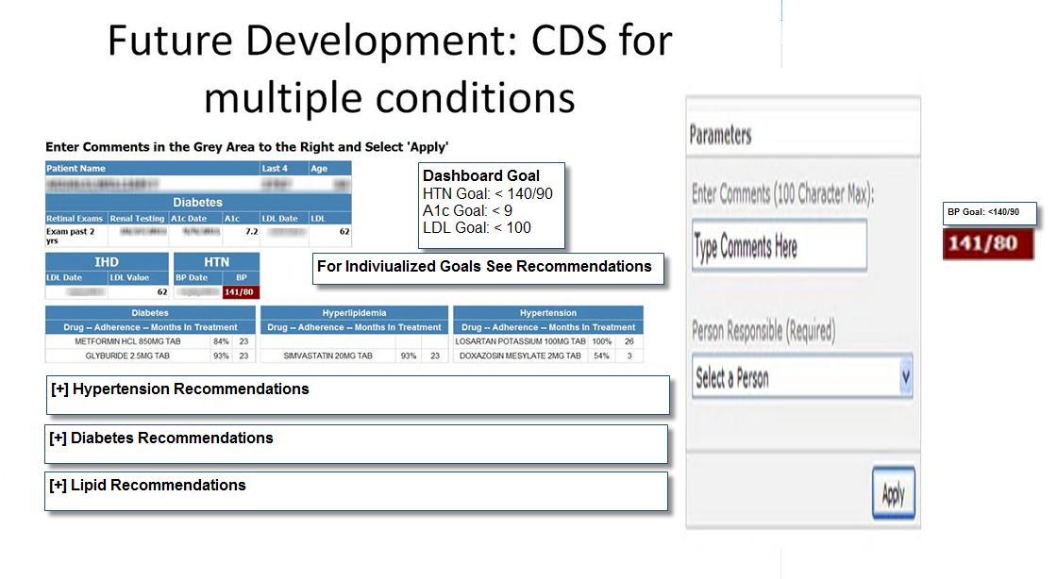
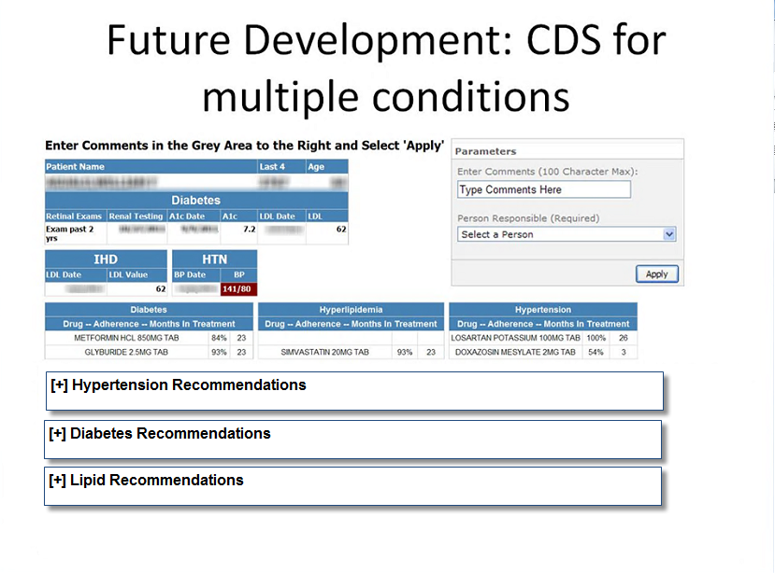

Slide 3

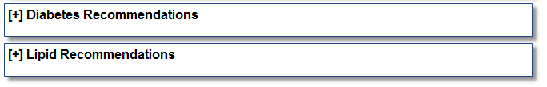
Order serum creatinine
Refer to dietitician
F/up 1month

Slide 4
EMR Data Transformation

Slide 5

OI&T Business Intelligence Service Line
Analytic Ecosystem
REGION 1
REGION 2
REGION 3
REGION 4
RDW
V1
V2
V3
V4
V5
MOSS Farm
RDW
V20
V19
V18
V22
V21
MOSS Farm
RDW
V12
V15
V16
V17
V23
MOSS Farm
VISTA Data
RDW
V6
V7
V8
V9
V10
V11
MOSS Farm
VISTA Data
VISTA Data
CDW
SAS Grid
VINCI
Web
Apps
ePM
GIS
MOSS Farm
VISTA Data
Enterprise
= Governance Board
Collaborative Research Using EHR to Advance Quality and Outcomes

Slide 6

Data Extraction Process
Regional Data Processing Center (x4)
Austin Automation Center
Regional Data Warehousing
Corporate
Nightly
Journal
reader
Shadowed Vista
Feeder
DB
RDW
DB
CDW
DB
Co-located Vista
Systems
Nightly
VISN
DWs

Slide 7
CDW Data Domains: Production
Appointments
Pharmacy, Inpatient, BCMA
Lab, Chemistry
Consults
Fee Basis
Orders
Health Factors
Immunizations
Inpatient (PTF, Movement)
Mental Health Assessment
Microbiology
Outpatient Encounters, ICD-9
Outpatient Problem List
PCMM
Pharmacy, Outpatient
Patient Demographics, Service
Staff
Vital Signs

Slide 8
CDW Data Domains: Raw
Allergies
Bill-Claims
Equipment Inventory
MyHealtheVet Secure Messaging
Pharmacy, Inpatient, IV
Pharmacy, Inpatient, Unit Dose
Pharmacy, Non VA Meds
Prosthetics 2.0
Radiology
Surgery 2.0
Engr. Work Orders
Emergency Department (EDIS)
TIU Documents
C&P Exams
Beneficiary Travel

Slide 9
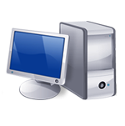
Data Collection and Distribution
Business
Intelligence
Reports, Dashboards
Clinician
Patient
Care
National SQL Database (cdw)
CPRS
VA’s Electronic Medical Record
GUI Interface
Data Processing Center
VistA Database
Notes:
Each VA facility collects patient information as part of routine patient care—this comprises the patient electronic medical record
This information is in turn housed in regional and national databases
When stored in these data warehouses, the information can be queried by data managers and then translated into real-time clinical dashboards and reports for providers to use and improve patient care

Slide 10
Population Management Dashboards
Amy Furman, PharmD
VISN 21 Data Warehouse Manager

Slide 11
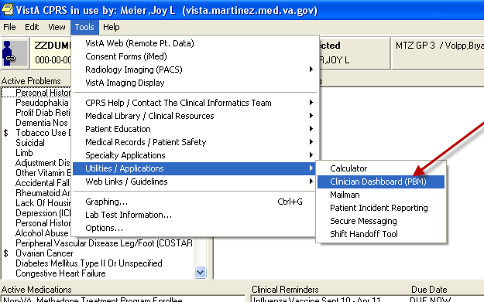

Slide 12
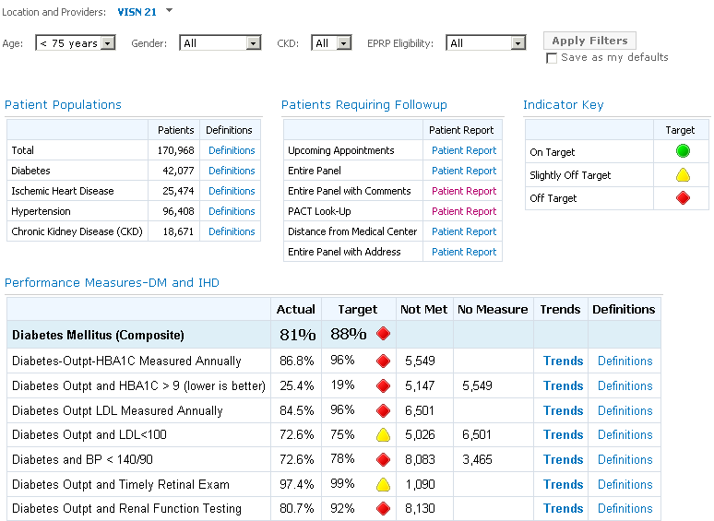
Primary Care Dashboard

Slide 13
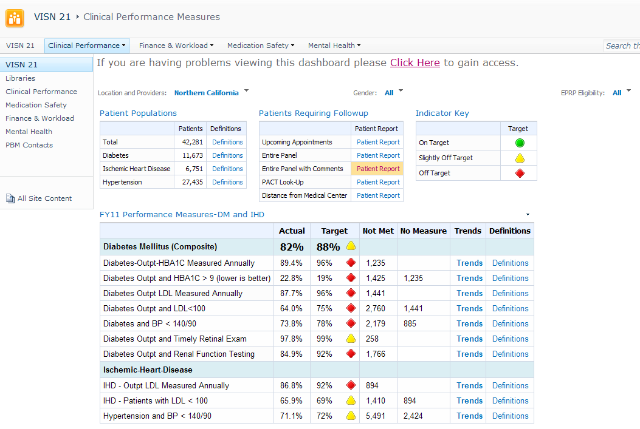
Updated dashboard panel report
Click to generate report of patients not meeting target goals

Slide 14
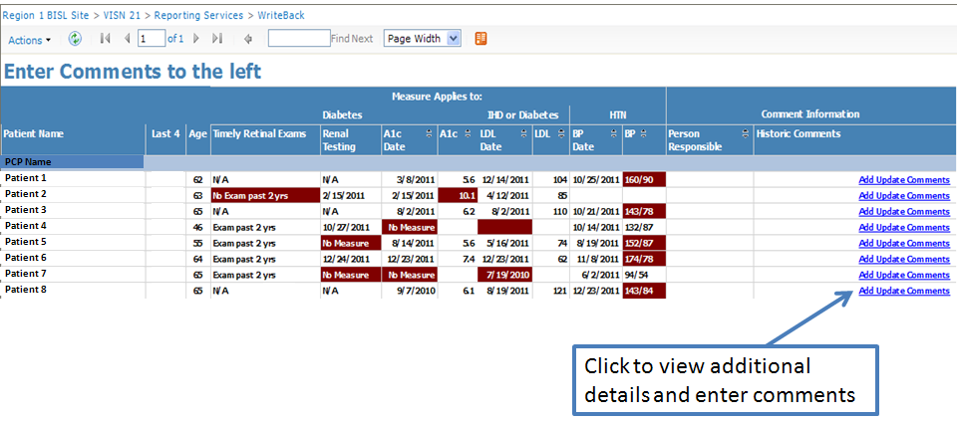
Write-Back Reports
Notes:
The patient name, SSN, age, and lab dates/values are on the report.
You can now run sorts on the reports by values and by assigned person responsible.
Click on add/update comments

Slide 15
Results
Performance Improvement

Slide 16
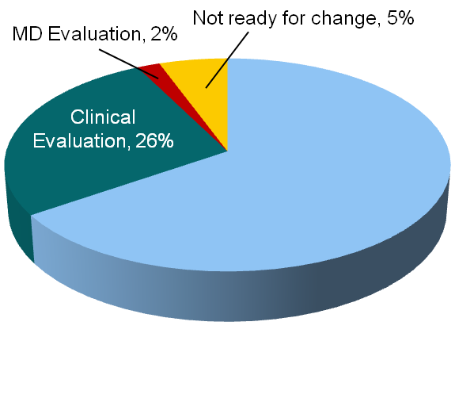
Results
Workload Distribution
Lipid Initiative
Glycemic Control
Clerical, 67%

Slide 17
Dashboard Diversification

Slide 18
Available Dashboards
Primary Care
Prevention
Osteoporosis
Pain
Oncology
Pharmacy Operations
Medication Safety
Warfarin/ESAs
Antibiotic Use
Cost Savings
Mental Health
Antipsychotic Use
PTSD
Alcohol Use
Metabolic Monitoring

Slide 19
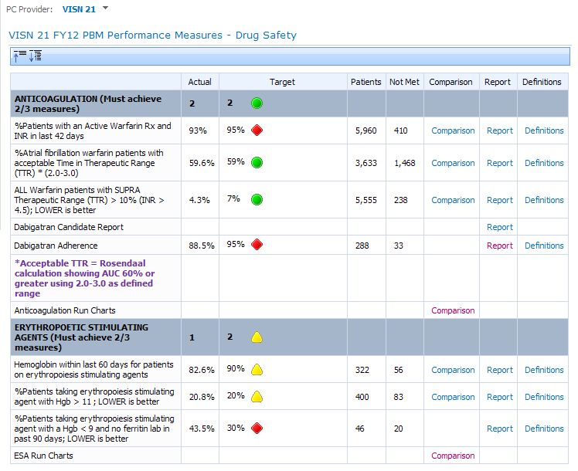
Warfarin/ESA Dashboard

Slide 20
Safety Measure Improvement on Selected Metrics
Measure | # of Patients | FY09 QT1 | FY10 QT3 | p value
Percent of patients with an active warfarin prescription and an INR in the last 42 days | 5,809 | 81% | 95% | p<0.0001
Percent of atrial fibrillation warfarin patients with 4 INRs in the last 6 months and Time in Therapeutic Range (TTR) > 60% | 5,328 | 53% | 69% | p<0.0001
Hemoglobin (Hgb) within the last 60 days for patients on erythropoietin stimulating agents (ESA) | 561 | 69% | 85% | p<0.0001
Percent of patients taking ESAs with Hgb > 12 | 449 | 18% | 7% | p=0.0004
Percent of patients taking ESAs with Hgb < 9 and no ferretin lab in the past 90 days | 62 | - | 22% | ---
PTSD patients with 0 or 1 benzodiazepine prescriptions in the past 90 days | 22,479 | 84% | 86% | p<0.0001
Percent of Atypical Antipsychotic (AA) patients without Metabolic Syndrome | 7,858 | 60% | 63% | p<0.0001
Percent of AA patients with 4 or more Metabolic Syndrome Markers measured | 7,858 | 83% | 88% | p<0.0001
The chi-square for the overall difference is significant, as are the proportion tests for the individual measures

Slide 21
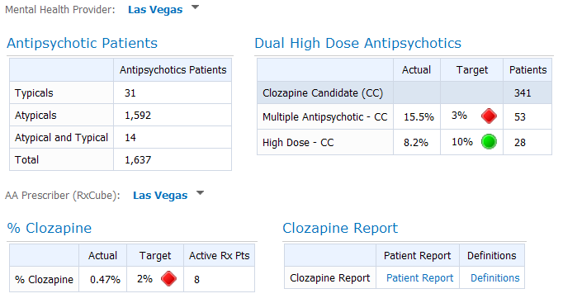
Clozapine Dashboard

Slide 22
Change in Clozapine Utilization For Schizophrenia FY10 to FY11

Slide 23
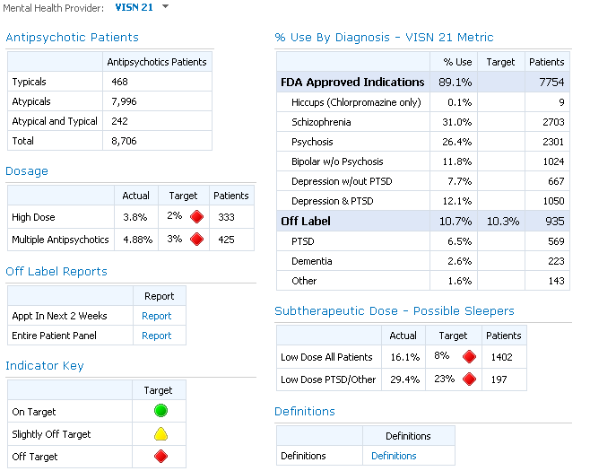
Off Label Antipsychotic Use

Slide 24
Changes in Antipsychotic Prescribing
p<0.001
p<0.001
p<0.001

Slide 25
Medication Safety Dashboard

Slide 26
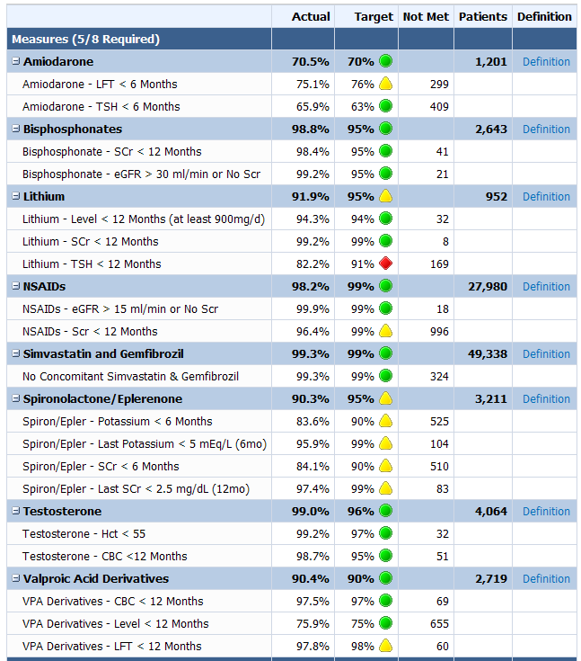
Measures

Slide 27
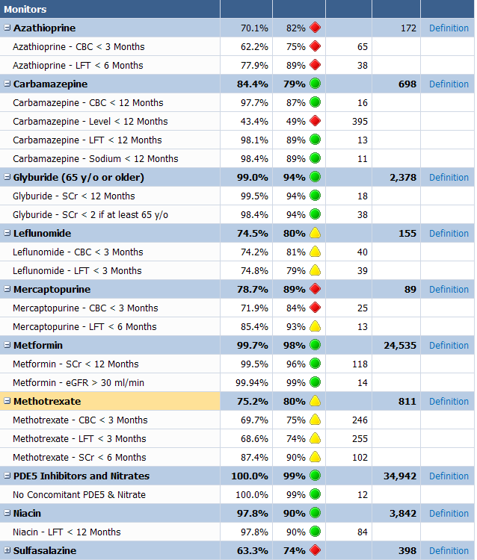
Monitors

Slide 28
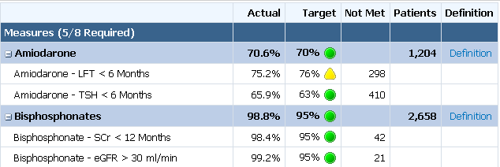

Measure Detail

Slide 29

Making a Difference Provider Drill to Detail

Slide 30
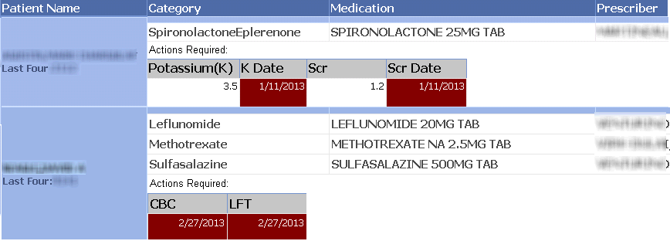
Making a Difference Provider Reports

Slide 31
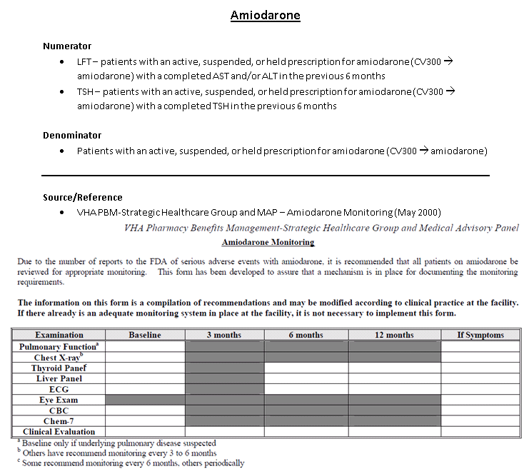

Slide 32
Usage Summary

Slide 33
Medication Safety Dashboard Hits
Notes:
2,144 Total Users
38% of all users in the region

Slide 34
Dashboard Hits

